Slide 1
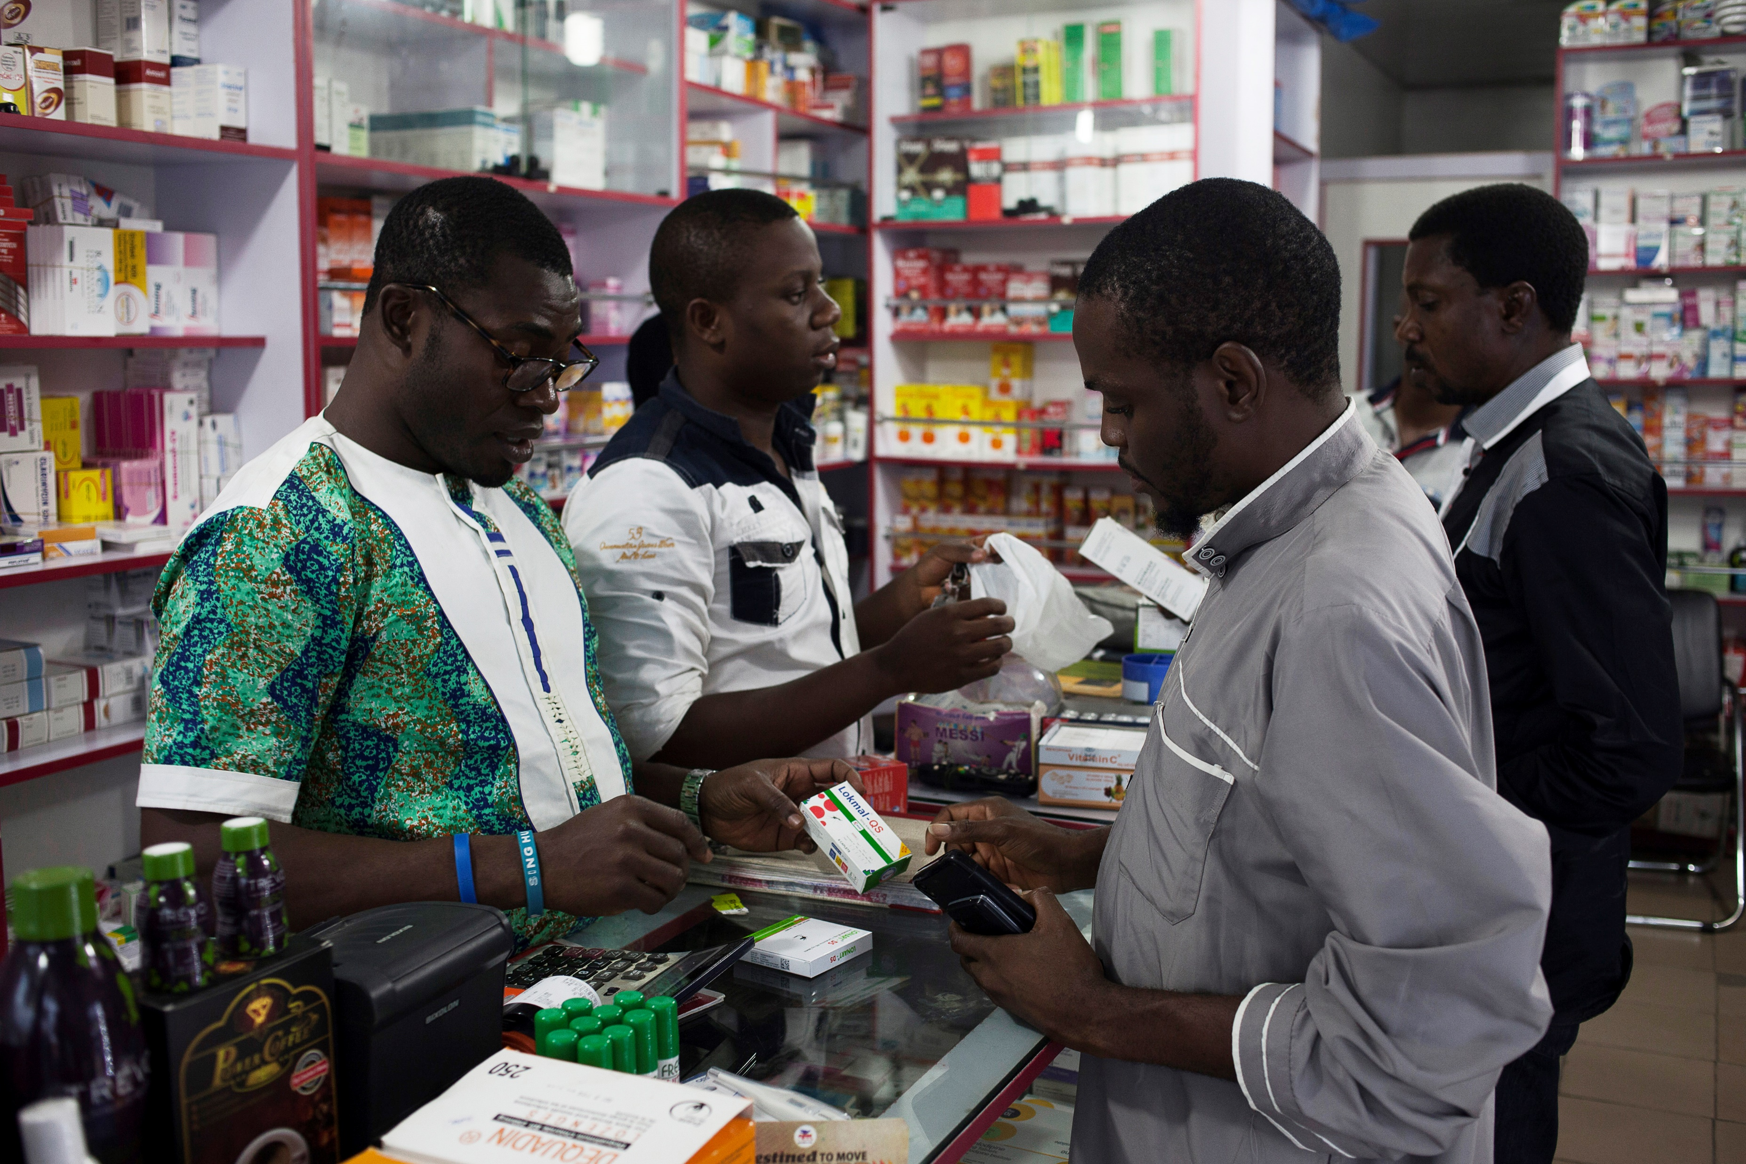

[Country, Year]
Antimalarial Audits:
Additional Practice

Slide 2
RULES
This is a quick test to see what we have learnt.
The following slides have pictures of 5 different products.
Complete an audit form for each product, using the information on the slide.
Do not discuss your answers – complete the form in silence.
We will mark your answers and give feedback (please put your name on each form, along with PRODUCT A, B, C, D, E...).
Aim: to assess progress, and identify areas where the group needs more training (if any!)
Good luck!

Slide 3
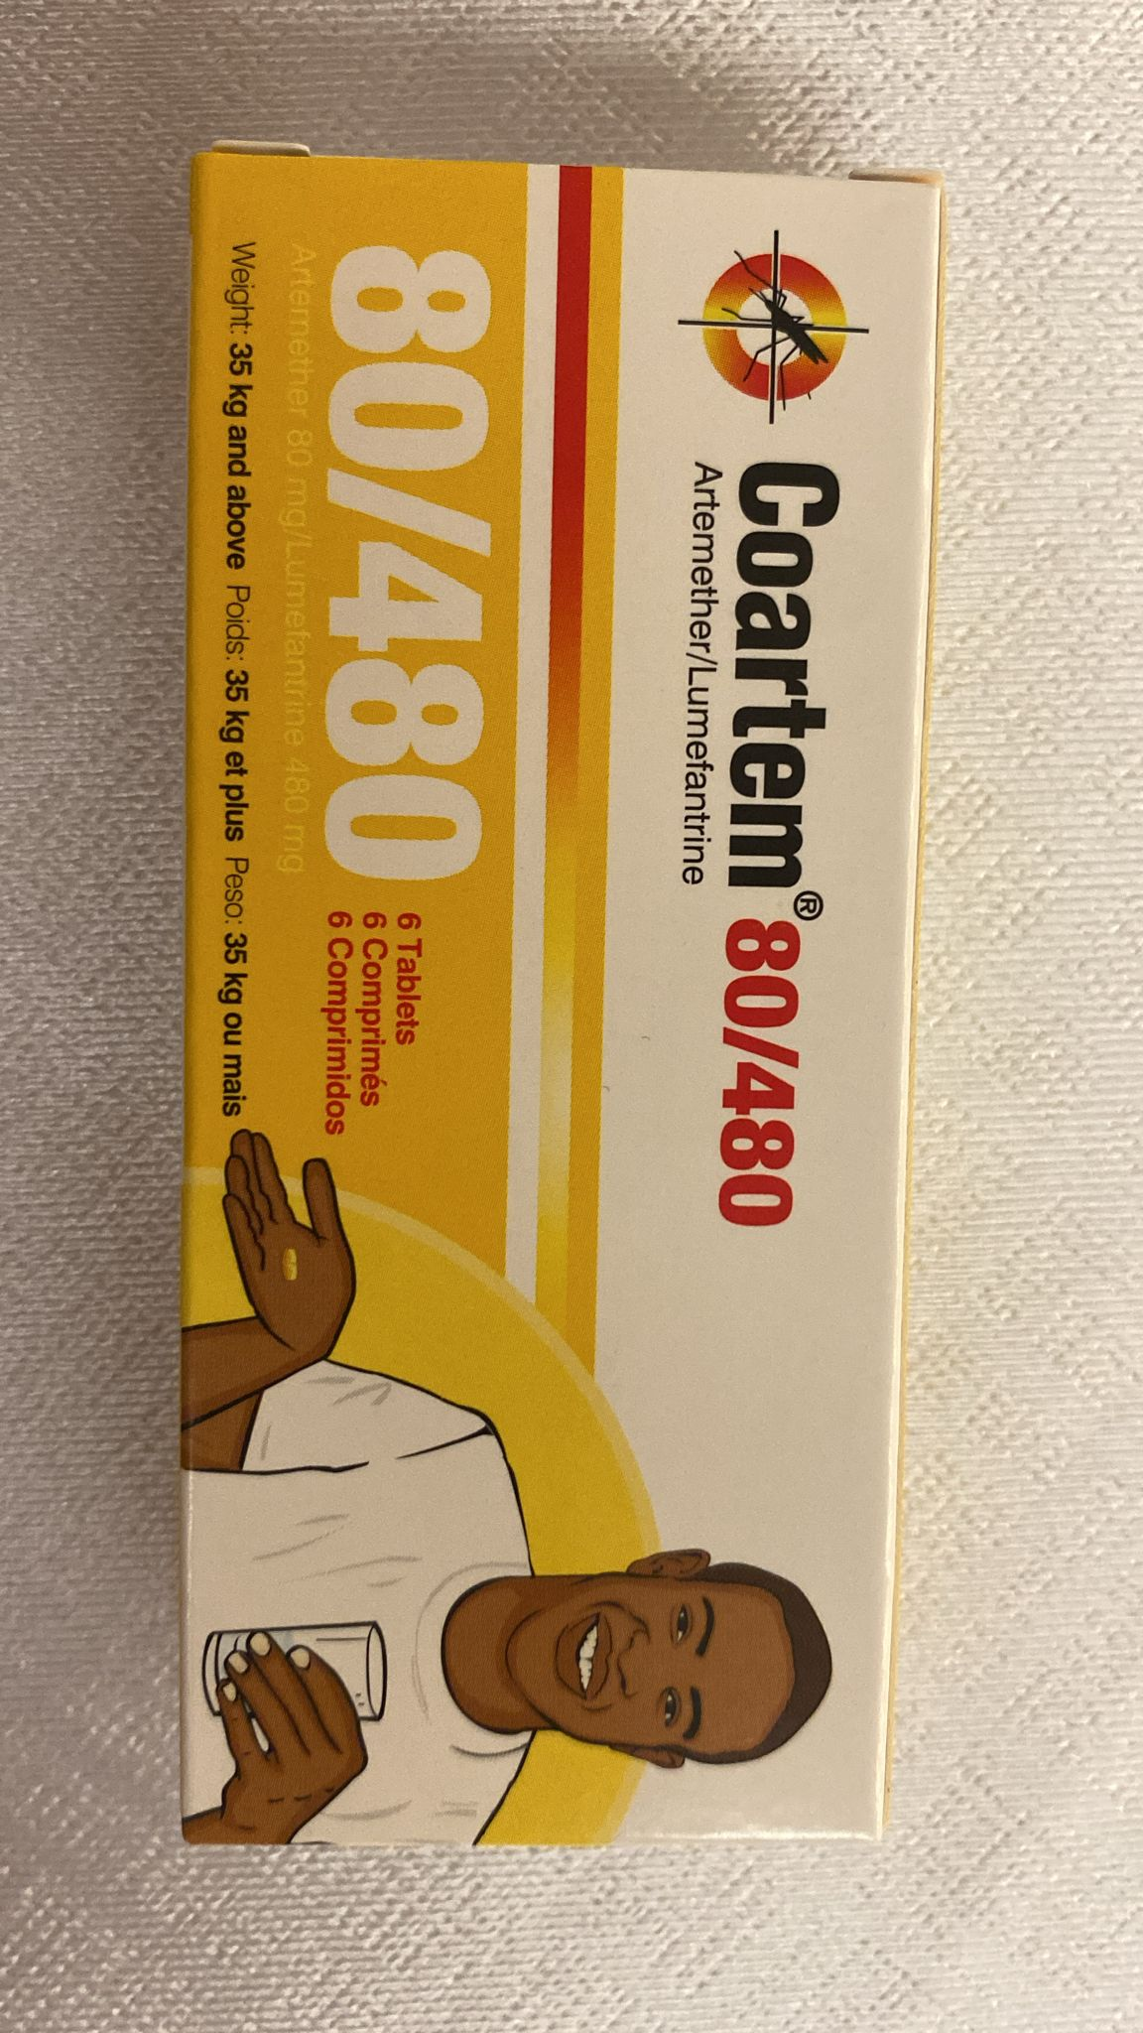
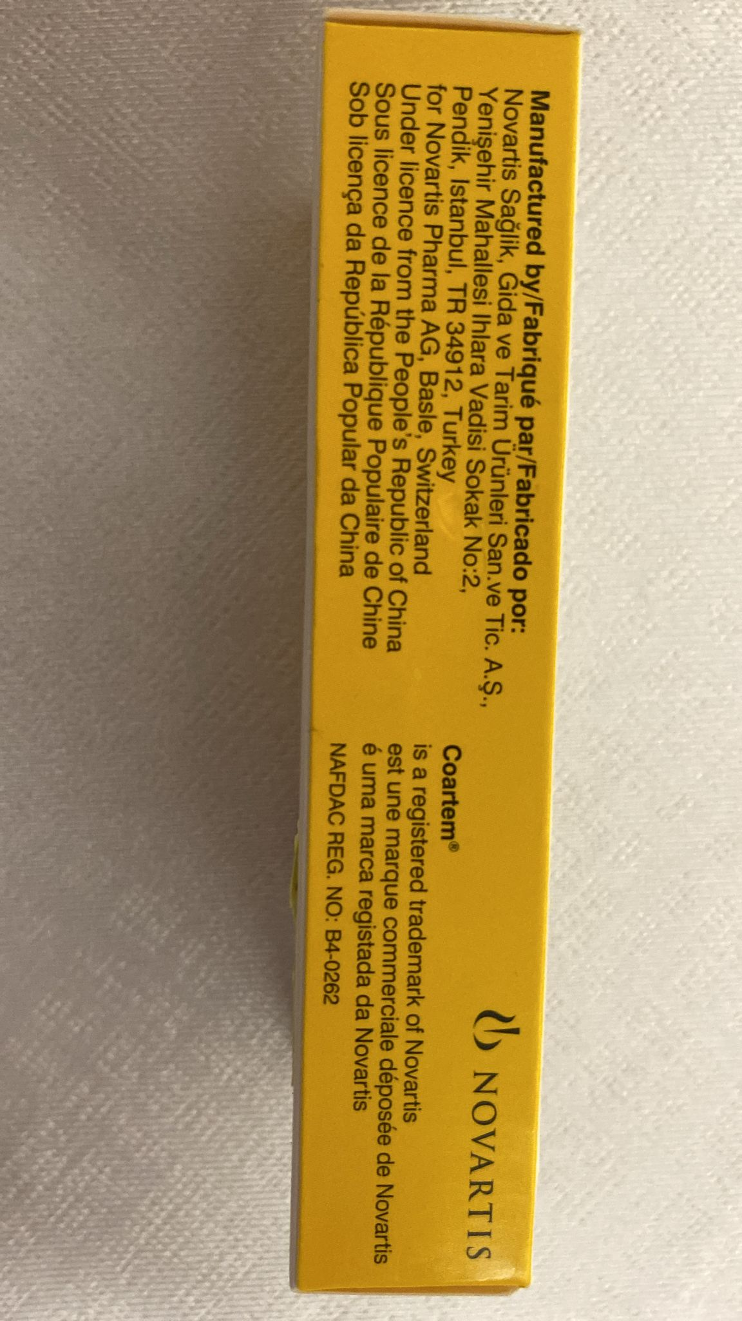
Product A
Note: update with project country currency and pricing.
The provider tells you:
They have sold 12 of this product to individual customers in the past week.
Each pack costs a customer XX.
This product has not gone out of stock in 2024.
They do not sell to other outlets.
They usually buy 25 packs at a time from their wholesaler for XX.

Slide 4
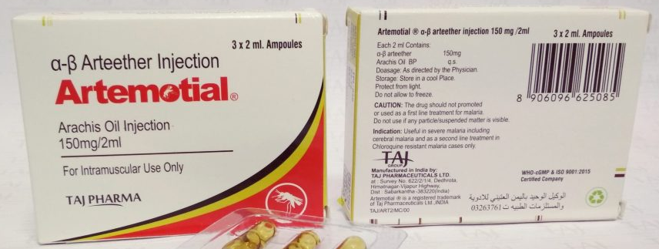
Product B
Note: update with project country currency and pricing.
The provider tells you:
They have sold 1 of this product to individual customers in the past week.
Each one costs a customer XX.
They did not have any in stock during April. Otherwise it is in stock.
They refuse to tell you if they sell to other outlets.
They refuse to tell you how much they purchase this product for wholesale.

Slide 5
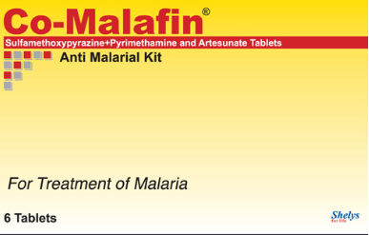
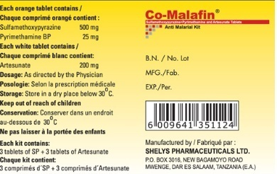
Product C
Note: update with project country currency and pricing.
The provider tells you:
They have sold 6 of this product to individual customers in the past week.
Each one costs a customer XX.
This product is usually in stock, but they can’t remember if it has stocked out in the past 3 months.
They sell this to PPMVs sometimes. There is no minimum order size. They sell it for XX.
They purchase this wholesale from wholesalers. They usually buy 10 big boxes of 10 packs each for XX.

Slide 6
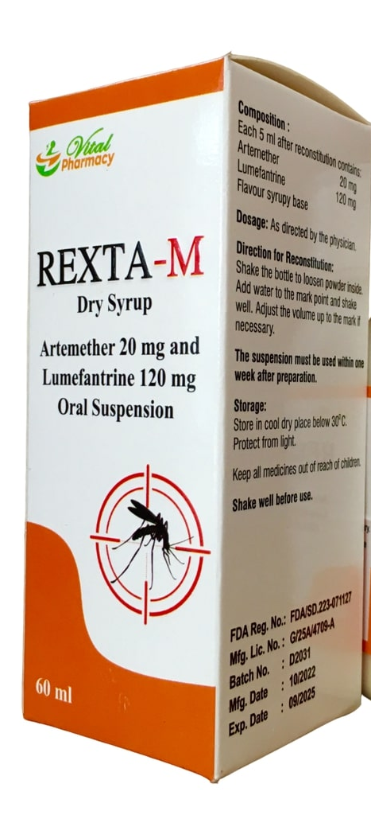
Product D
Note: update with project country currency and pricing.
The provider tells you:
This product is very popular at the moment – they sell 25 a week on average.
Each one costs a customer XX.
It is always in stock.
They sell to other outlets. The minimum order size is 10 packs. They do not know how much this costs.
They purchase this in boxes of 100 packs from their wholesaler. They do not know how much this costs.

Slide 7
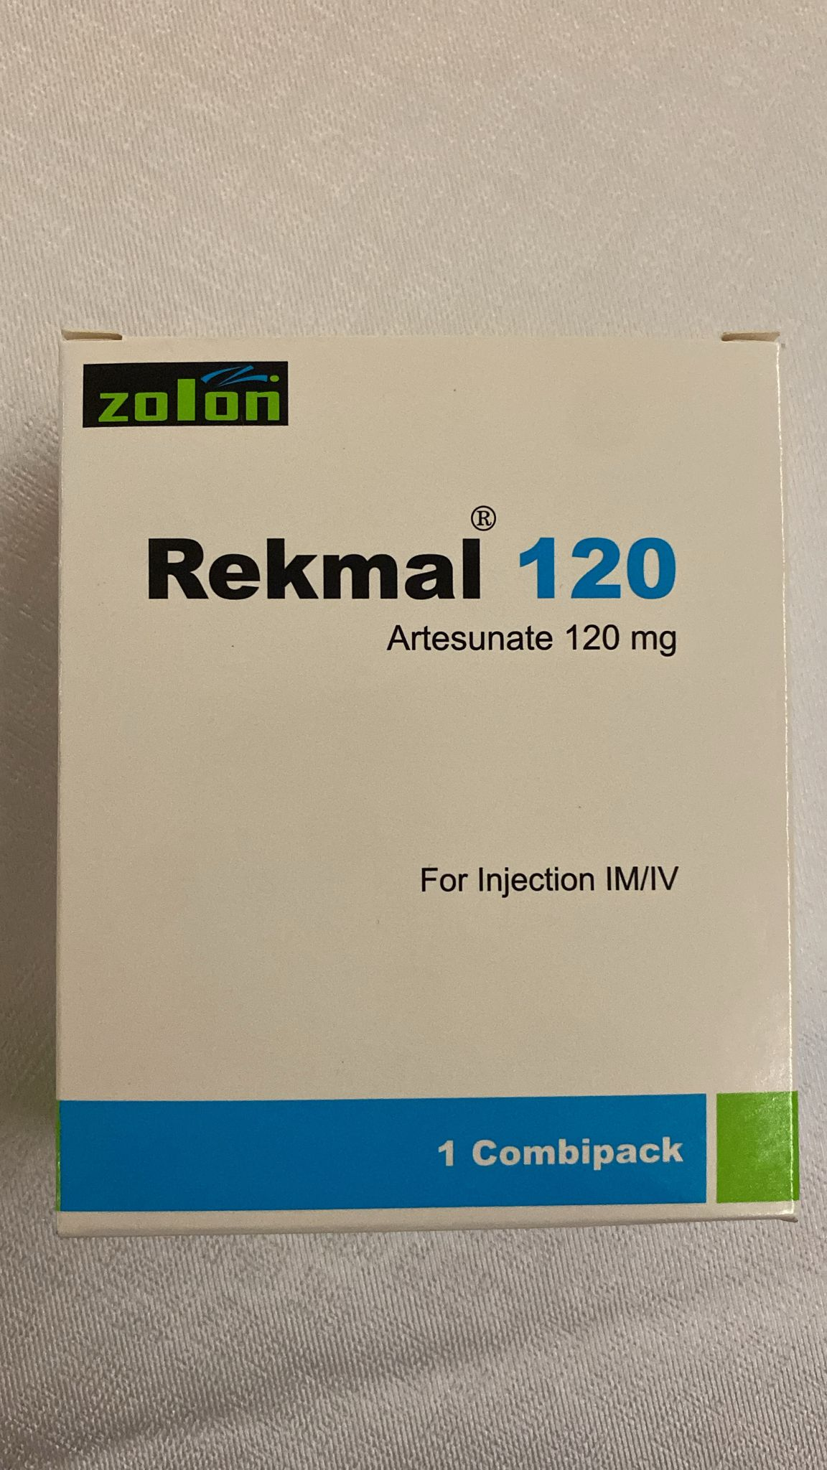
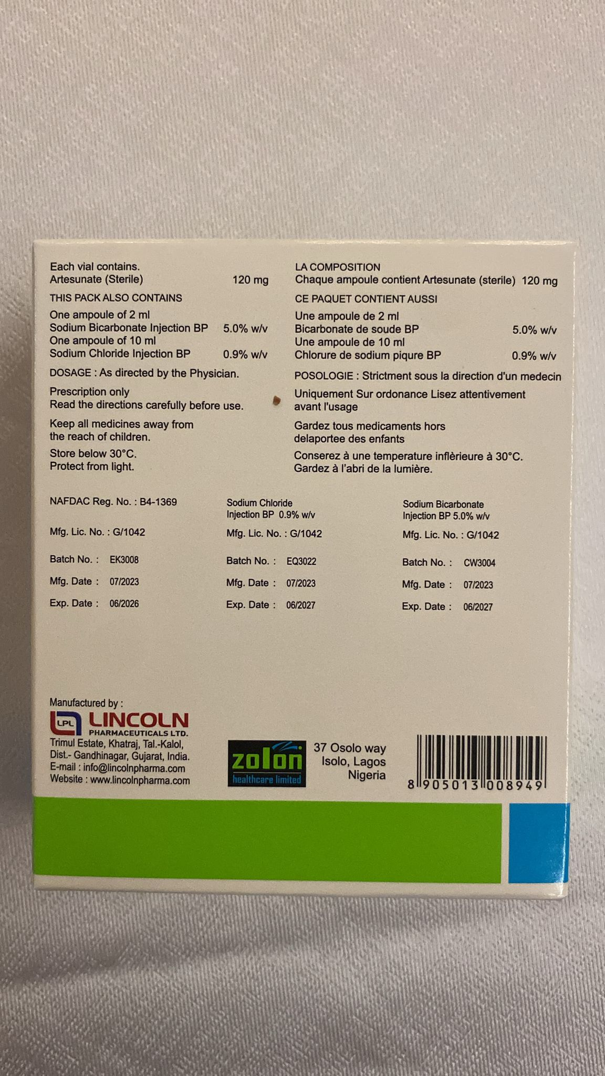
Product E
Note: update with project country currency and pricing.
The provider tells you:
Last week they sold 6 of these, but usually they sell 2 per week.
Each one costs a customer XX.
They ran out of stock for about 1 week last month, but it is otherwise in stock.
They do not sell to other outlets.
They refuse to tell you about their wholesale volume or prices.

Slide 8
ANSWERS

Slide 9
Model Answers PRODUCT A
Dosage form: TABLET
Brand name: COARTEM 80/480 [CAN ALSO INCLUDE: WEIGHT 35KG AND ABOVE]
Manufacturer name: NOVARTIS PHARMA AG
Manufacturer country: TURKEY
Active ingredients: ARTEMETHER ; LUMEFANTRINE
Strengths: 80MG ; 480MG
Salts: NONE
FDC: YES
Pack type: INDIVIDUAL PACKET
Pack size: 6
Stocked out: NO
Quantity sold in past 7 days to retail customers: 12
Price to retail customers: XX
Quantity sold at wholesale: N/A
Wholesale price for resale customers: N/A
Price purchased from supplier: 25 PACKS FOR XX
Note: update with project country currency and pricing.

Slide 10
Model Answers PRODUCT B
Dosage form: LIQUID INJECTION
Brand name: ARTEMOTIAL
Manufacturer name: TAJ PHARMACEUTICALS LTD
Manufacturer country: INDIA
Active ingredients: ARTEETER
Strengths: 150MG/2ML
Salts: NONE
FDC: N/A (YES ALSO ACCEPTABLE ANSWER)
Pack type: AMPOULE OR VIAL
Pack size: 3
Stocked out: YES
Quantity sold in past 7 days to retail customers: 1
Price to retail customers: XX
Quantity sold at wholesale: REFUSED
Wholesale price for resale customers: REFUSED
Price purchased from supplier: REFUSED
Note: update with project country currency and pricing.

Slide 11
Model Answers PRODUCT C
Dosage form: TABLET
Brand name: CO-MALAFIN (CAN ALSO INCLUDE: “ANTIMALARIAL KIT”)
Manufacturer name: SHELYS PHARMACEUTICALS LTD
Manufacturer country: TANZANIA
Active ingredients:
SULFAMETHOXYPYRAZINE; PYRIMETHAMINE; ARTESUNATE
Strengths: 500MG; 25MG; 200MG
Salts: NONE
FDC: NO
Pack type: INDIVIDUAL PACKET
Pack size: 6
Stocked out: DON’T KNOW
Quantity sold in past 7 days to retail customers: 6
Price to retail customers: XX
Quantity sold at wholesale: 1
Wholesale price for resale customers: XX
Price purchased from supplier: 100 (BECAUSE 10X10) PACKS FOR XX (BECAUSE EACH BOX OF 10 COSTS XX)
Note: update with project country currency and pricing.

Slide 12
Model Answers PRODUCT D
Dosage form: SUSPENSION
Brand name: REXTA-M DRY SYRUP
Manufacturer name: CANNOT TELL FROM PICTURE
Manufacturer country: CANNOT TELL FROM PICTURE
Active ingredients: ARTEMETHER; LUMEFANTRINE
Strengths: 20MG; 120MG
Salts: NONE
FDC: N/A (YES, ALSO ACCEPTABLE RESPONSE)
Pack type: BOTTLE
Pack size: 60ML
Stocked out: NO
Quantity sold in past 7 days to retail customers: DON’T KNOW : SHOULD CONFIRM THAT 25 WERE SOLD IN THE PREVIOUS 7 DAYS
Price to retail customers: XX
Quantity sold at wholesale: 10 PACKS
Wholesale price for resale customers: DON’T KNOW
Price purchased from supplier: 100 PACKS, PRICE: DON’T KNOW.
Note: update with project country currency and pricing.

Slide 13
Model Answers PRODUCT E
Dosage form: POWDER INJECTION
Brand name: REKMAL 120
Manufacturer name: LINCOLN PHARMACEUTICALS
Manufacturer country: INDIA
Active ingredients: ARTESUNATE
Strengths: 120MG
Salts: NONE
FDC: N/A (BUT YES ALSO ACCEPTABLE RESPONSE)
Pack type: AMPOULE OR VIAL
Pack size: 120MG
Stocked out: YES
Quantity sold in past 7 days to retail customers: 6
Price to retail customers: XX
Quantity sold at wholesale: N/A
Wholesale price for resale customers: N/A
Price purchased from supplier: REFUSED
Note: update with project country currency and pricing.

